Slide 1
FCC3 246: CONCRETE MATERIALS
Lecture 2: WHY CONCRETE?
Department of Civil & Construction Engineering
University of Nairobi
mwauras@uonbi.ac.ke

Slide 2
Why concrete?
Concrete is an artificial building material that is made up by mixing Cement, Aggregates and Water
Concrete = Cement + Fine Aggregate + Coarse Aggregate + Water
Next to water, concrete is the most abundantly used construction material on Earth.
In terms of cost per tonne, concrete is cheaper than any other construction material.
It is also one of the most convenient and versatile construction materials since:
  the ingredients are widely available
  anyone can make it
  it can be cast anywhere into any form
  it sets hard at ambient temperatures

Slide 3
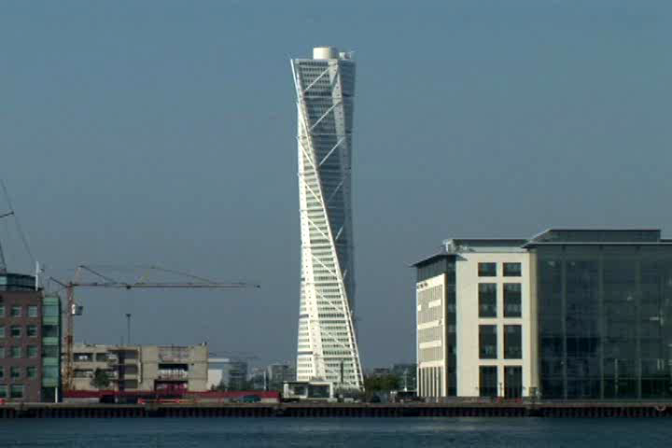

Slide 4
Why concrete?
Moreover, when made properly, concrete is very durable as it does not corrode like metal, rot like timber or degrade in sunlight like plastics. In fact, unlike any other construction material, concrete can become stronger and better as it ages.

Slide 5

Essential Properties of Concrete
Have sufficient strength
Looks good (aesthetics)
Lasts a long time (durable)
Cost as little as possible (construction & maintenance)

Slide 6

The durability of a structure
may be defined as the time
for which the structure
can fulfil the function
for which it was
designed and constructed
The Pantheon in Rome is a testament to the durability of concrete. Built nearly
2000 years ago, this unreinforced 43m diameter dome is still in use today.

Slide 7
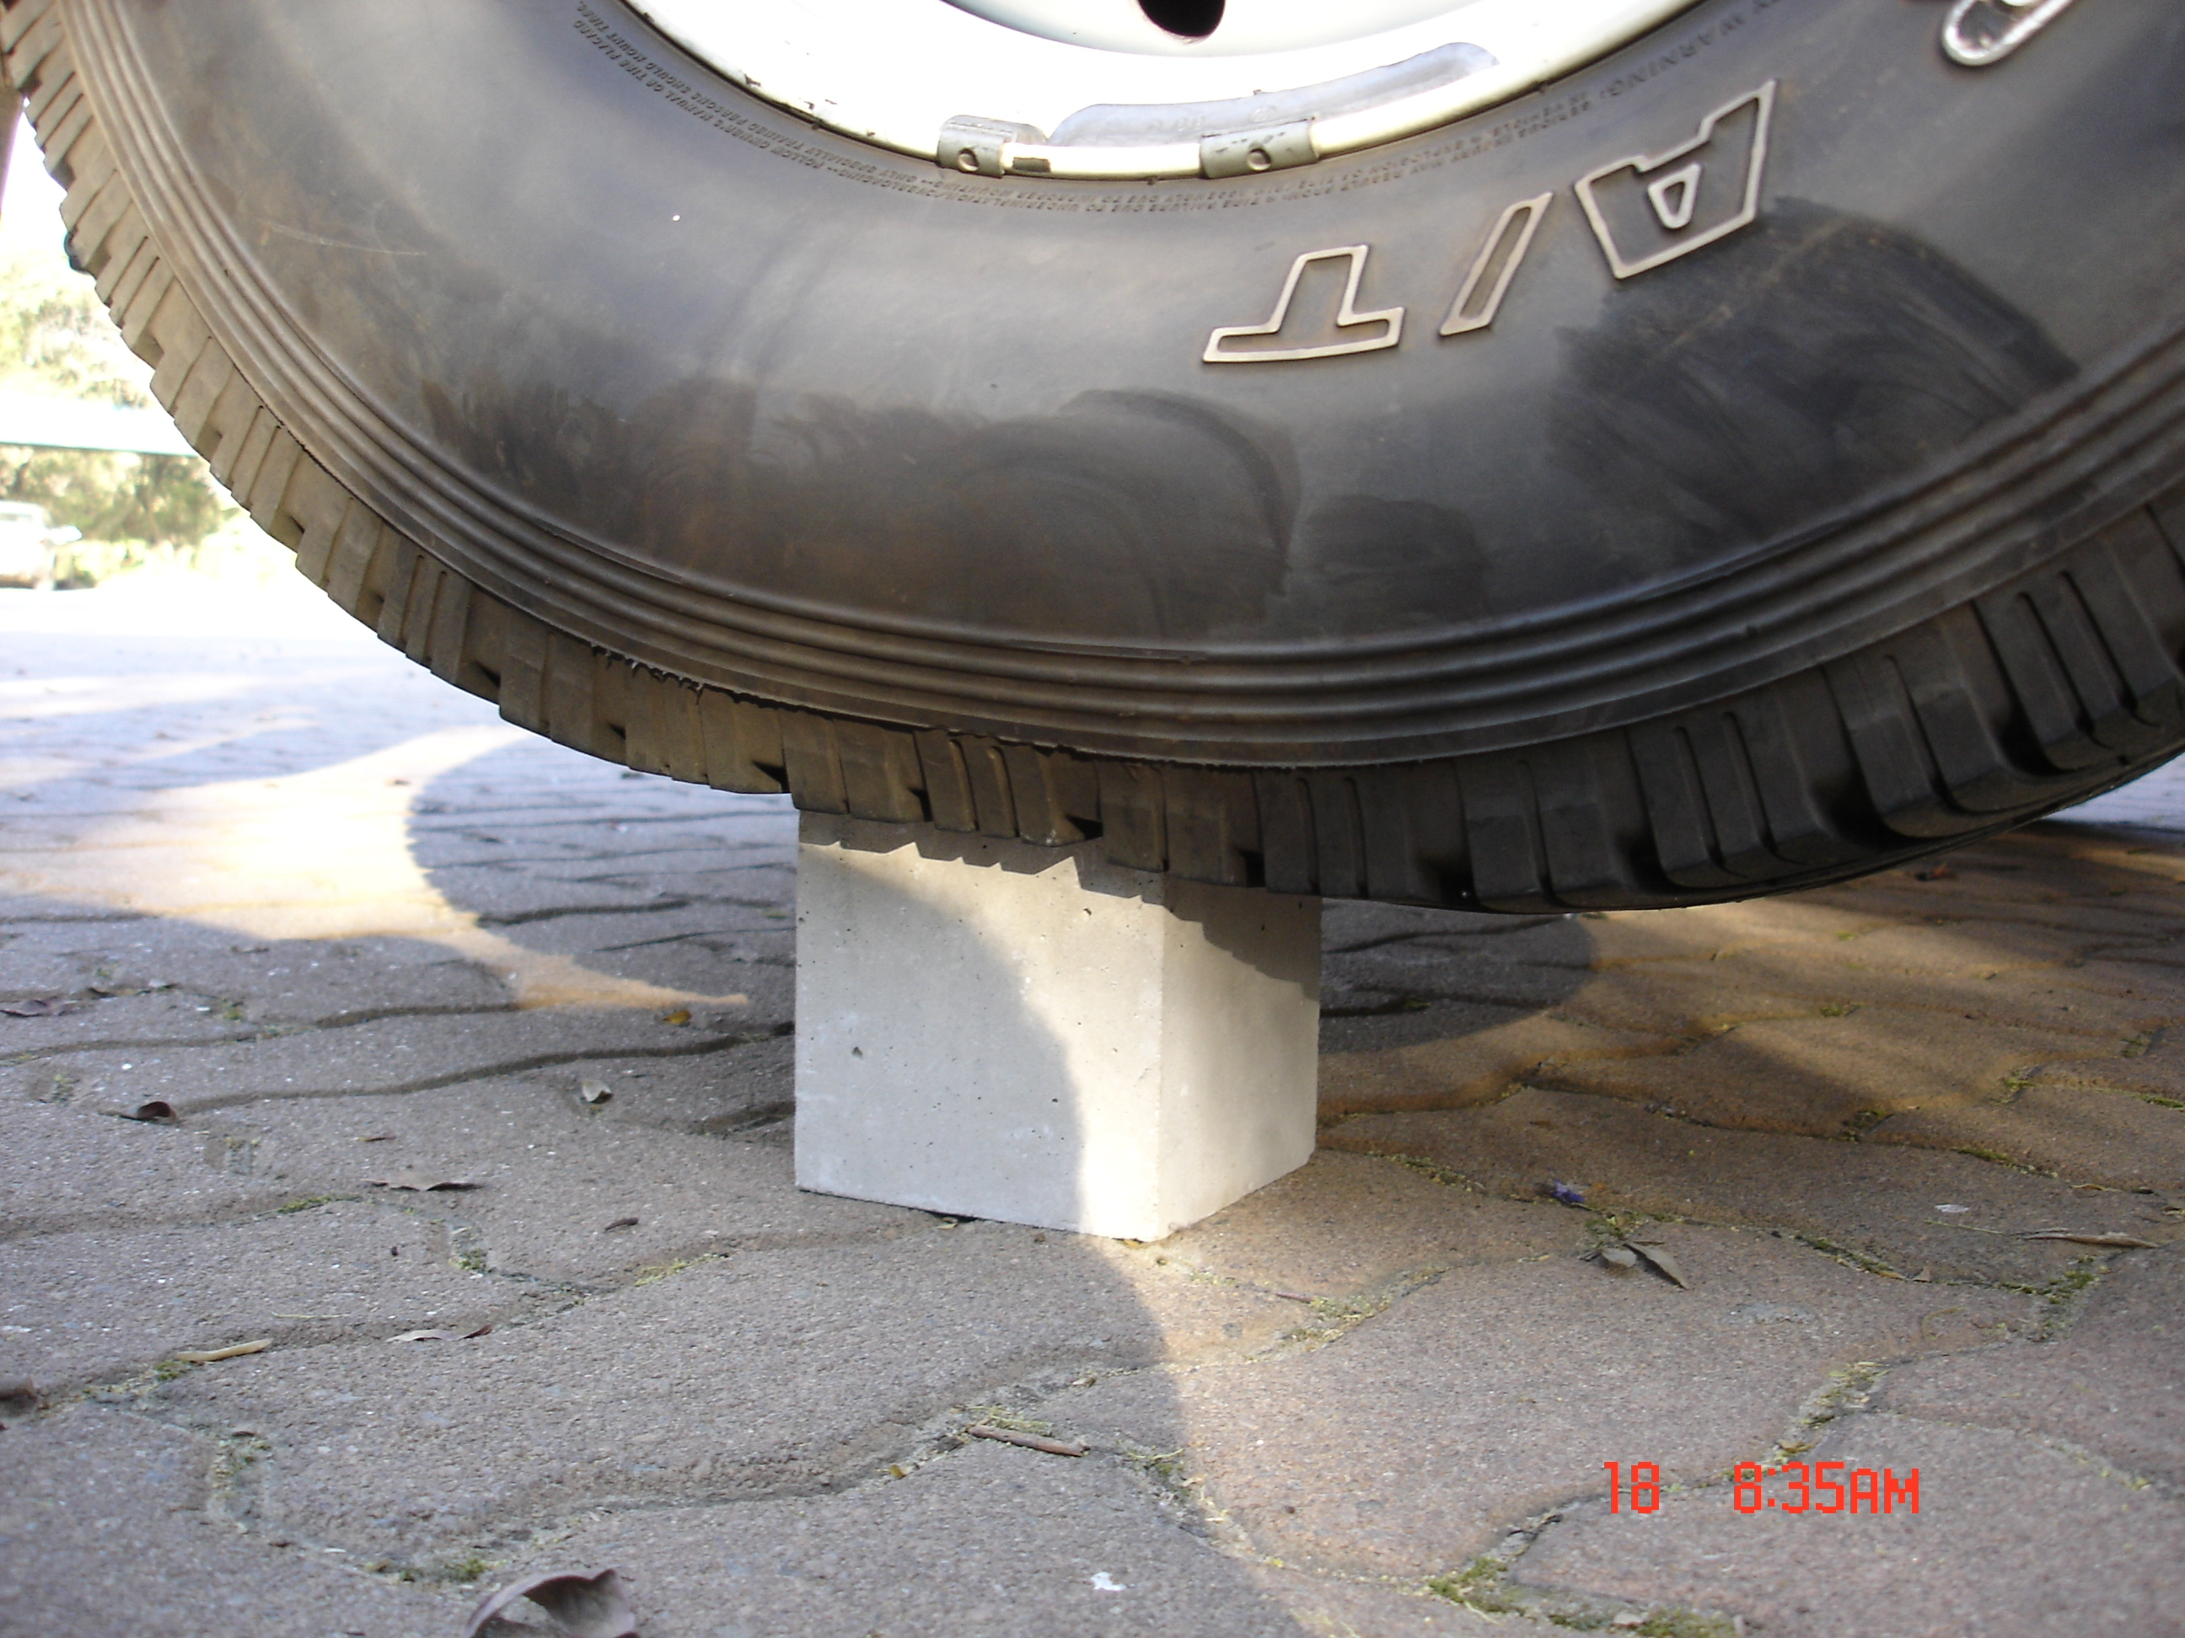
Understanding the nature of concrete
Concrete is strong in compression but weak in tension.
In fact, concrete’s compressive strength is about one order of magnitude (that is about ten times) higher than its tensile strength.

Slide 8




Where possible, concrete structures are built in an arch or
dome shape to ensure the principle stresses are in compression.

Slide 9
Factors that govern the strength of concrete
There are many factors that influence the potential strength of concrete but the most important two are the water:cement ratio; the voids content, and the proportion of ingredients.
W:C =
Mass of water
Mass of cement

Slide 10
The water content of concrete
For everyday practice, a w:c ratio of 0.2 is too low to produce workable and economic concrete. Concrete with such a low w:c ratio is either very expensive or very dry.
To achieve good compaction using normal equipment on site, we need to add more water. This extra water makes the concrete workable so that we can compact it - but it does so at the cost of strength.

Slide 11
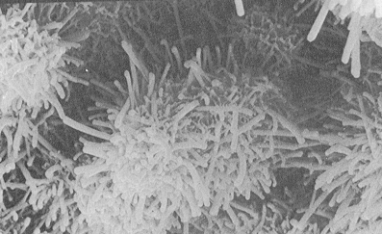
Components
Cement
Hydration (Paste)
Water
Lubrication
Water requirement
Water Retentivity
Sand
Void Filler
Bulk
(Little Effect on Strength)
Stone
Dimensional Stability
Abrasion Resistance-

Slide 12
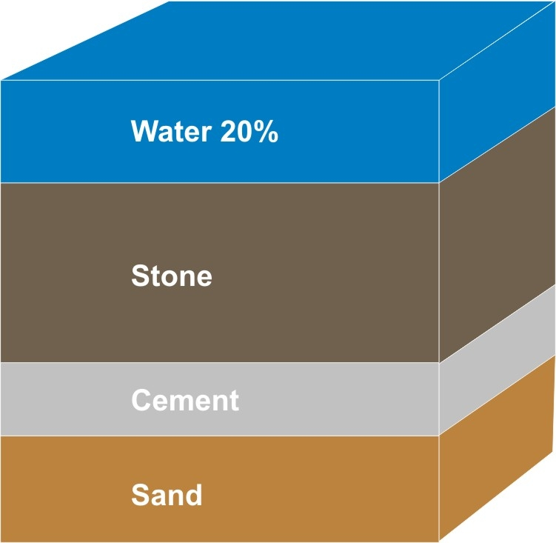
To make a cubic meter of concrete with a slump of 75mm, using ordinary materials, will require about 200 liters of water.
That means that this water occupies 20% or 1/5th of the volume of the concrete!
By careful selection of materials, good mix design and use of admixtures, it may be possible to reduce the water content to 170 ℓ/m³ but it is difficult and costly to do better than this.

Slide 13
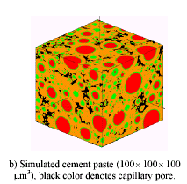
So what happens to the water that occupies 20% of the volume of concrete?
The rest of it remains within
the concrete structure trapped
within the pores and gel
3
Some of it gets lost
by evaporation and
absorption causing
shrinkage and forming
voids
2
1
Some of it gets consumed by the
hydration reaction where it
becomes part of the solid crystal
microstructure

Slide 14

Wise words concerning water !!!
“I’ve talked for a long time about the fact that we need a system of making concrete where we give the cement away free and we charge $10 a gallon for special water to mix it with, and it won’t set and harden unless you mix it with the special water.
That will make people cut down on the water – 99% of everything that’s wrong with concrete is the result of people putting in too much water.”
Brian Mather, 2000

Slide 15

Hardening of concrete
Unlike mud which becomes hard as a consequence of drying, concrete sets and gains strength because of a chemical reaction between grains of cement and water. This chemical reaction is called hydration and is exothermic.
Hydration (and its associated strength gain) will stop if the concrete
dries out. Freshly placed concrete must therefore be kept wet (cured).

Slide 16
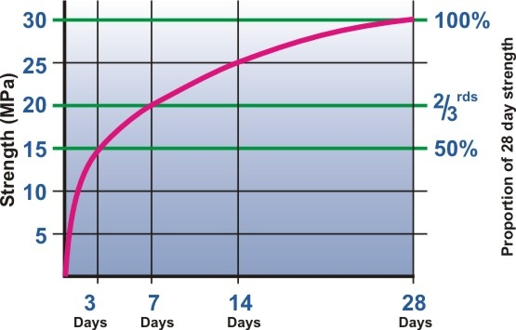
The hardening and strengthening process
10
This graph illustrates the typical rate at which normal portland cement concrete gains strength at an ambient temperature of about 20⁰C. Alteration of the type of cement and temperature would change the exact shape of the curve. The curve is an inverse log function.

Slide 17
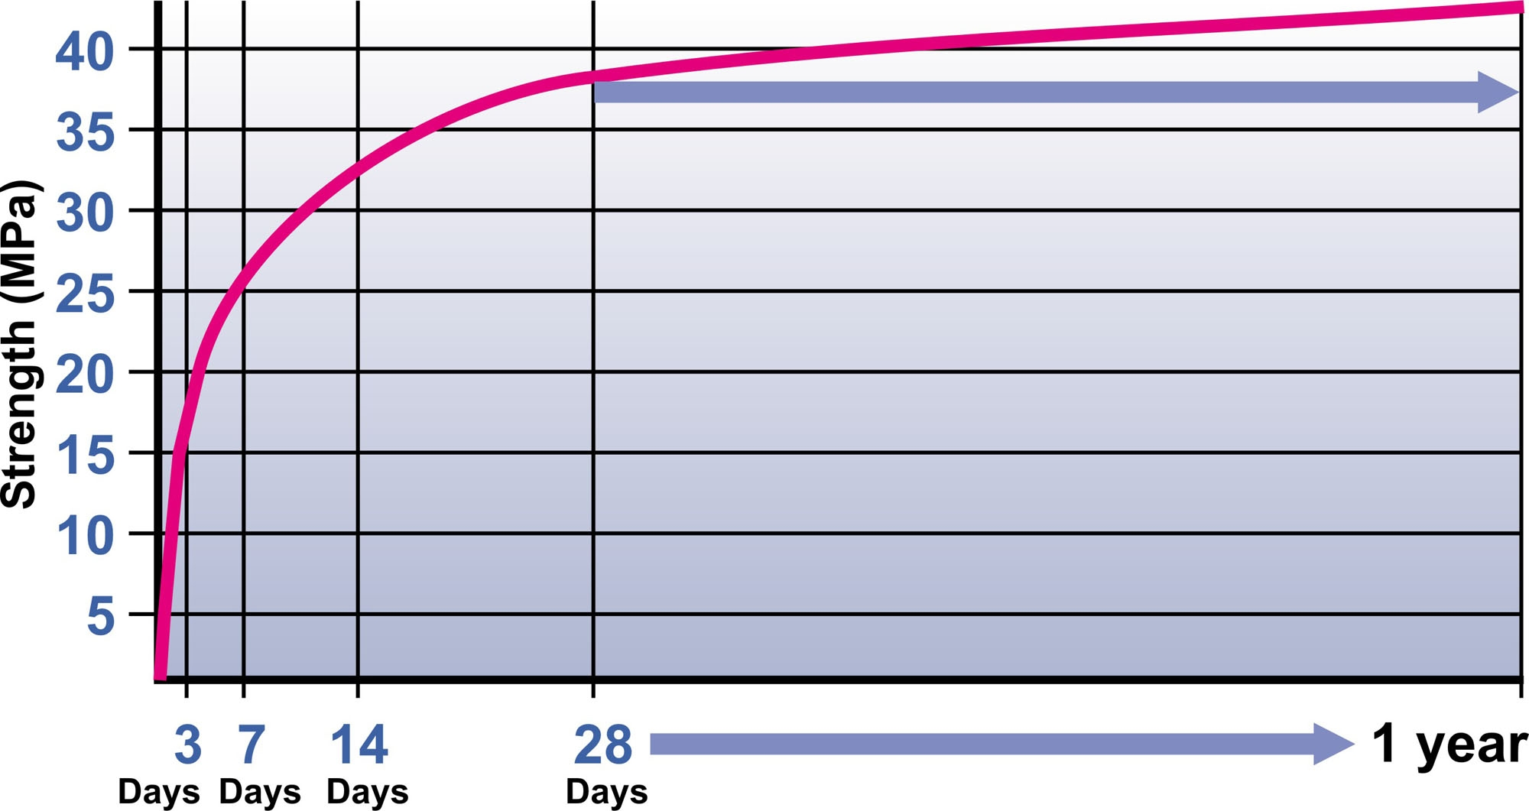
When does concrete reach its full strength?
10
For convenience, engineers often specify concrete strength at 28 days. This should not be taken to imply that at 28 days the concrete stops gaining strength. As long as there is both unhydrated cement and water present, concrete has the potential to gain strength. If fact, measurable strength gains have been recorded after six years and in theory, concrete made in Roman times is becoming stronger day by day. In large dams, it is not uncommon for engineers to specify strengths at 56 or 90 days.

Slide 18
Specified Characteristic Strength
18
The strength specified by an engineer is known as the:
  specified strength or
  characteristic strength or
  specified characteristic strength (S.C.S)
It is defined as the strength below which no more than 5% of the test results may fall.

Slide 19
SCS vs. TMS
19
The strength of the concrete that the Contractor must achieve on site is called the:
  Target Mean Strength (TMS) or
  Target Average Strength (TAS)
It is defined as the SCS + the margin of the concrete (dependant on the standard deviation)

Slide 20
Compaction
20
Entrapped air in the concrete
  1% air reduces concrete strength by 6%
  It increases permeability
  Reduces bond to steel
  Voids are aesthetically displeasing
Protect steel reinforcement
Off shutter finish-

Slide 21
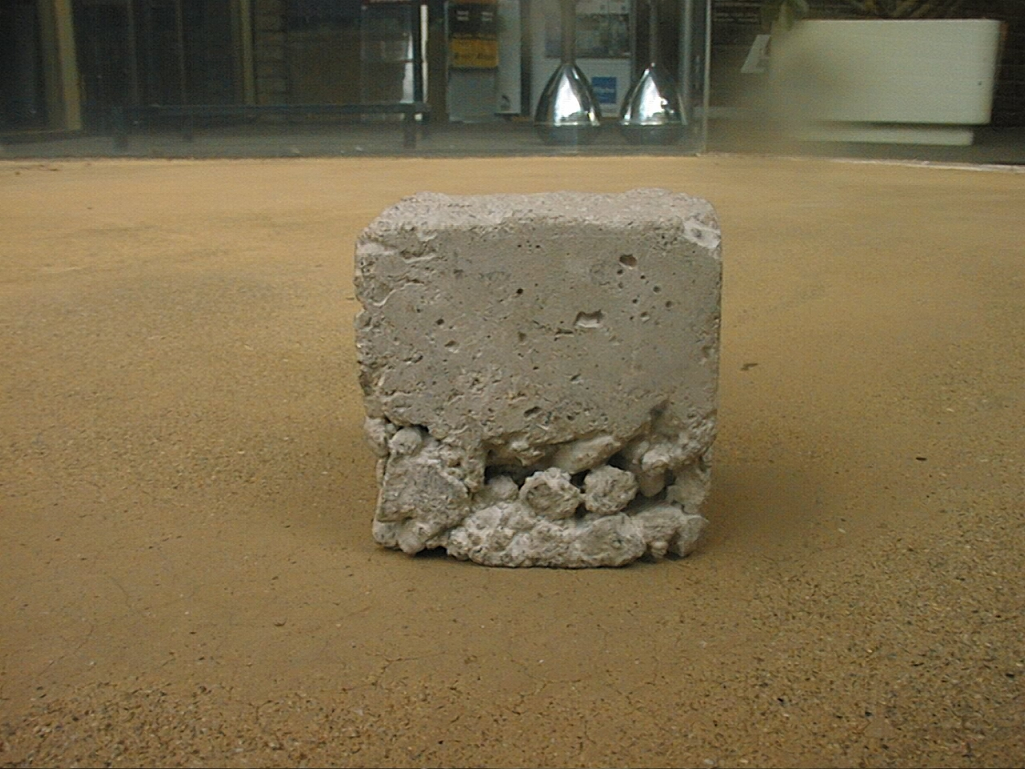
For every 1% excess voids in concrete, we lose 5-6% strength.
In this cube there are about 5% excess voids.
What would you estimate the loss in strength to be?

Slide 22
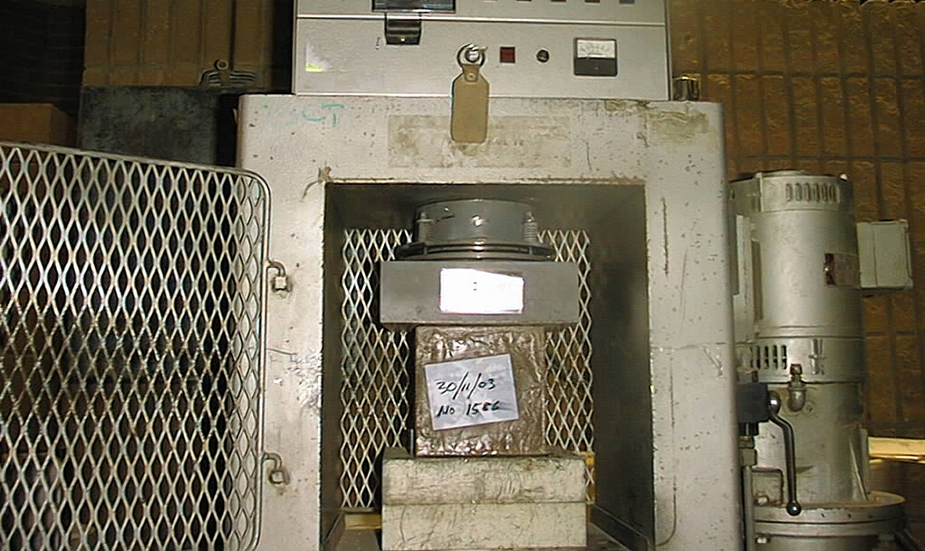
But there is no such thing as “pure” compression
22
Even as we apply a ‘pure’ uniaxial compressive load to this
concrete cube, it experiences tension forces as it tries to dilate
(bulge). It is concrete’s ability to resist these secondary tensile
forces that ultimately determines its strength. In this respect,
the strength of concrete is like the strength of a chain.

Slide 23
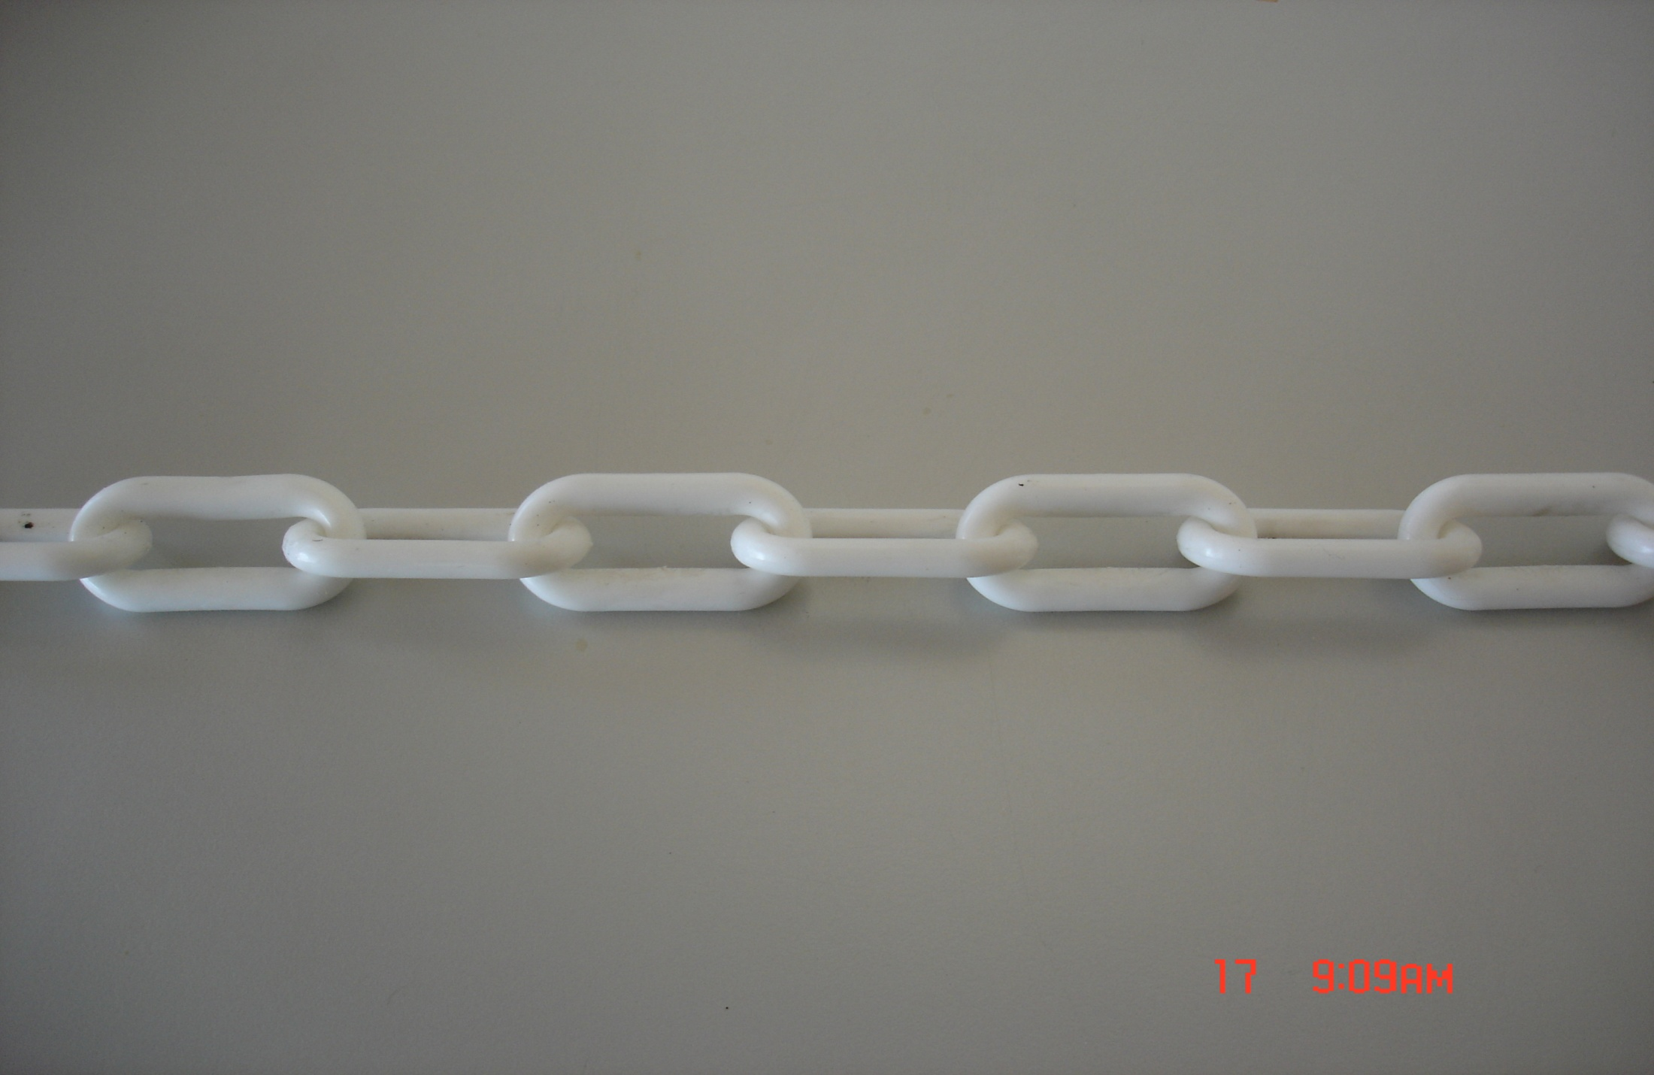
The chain is as strong as its weakest link
Imagine a chain with only weak plastic links. If we were to
remove some of these weak plastic links and substitute some
strong steel links, would we be making the chain stronger?

Slide 24
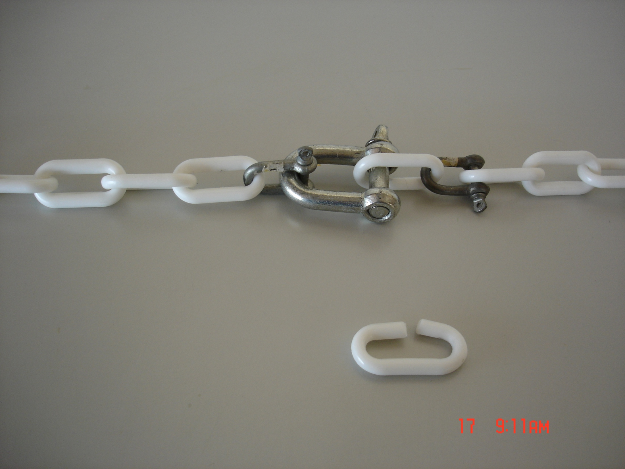
In the analogy of the chain, the plastic links represent the weaker
cement paste matrix and the steel links represent the strong
aggregate particles. Aggregate strength has little effect on the
strength of the concrete. To make concrete stronger, we have to
strengthen the weakest links. Aggregates are therefore used
not primarily for imparting strength to concrete but mainly for
economy and to combat concrete’s shrinkage.

Slide 25
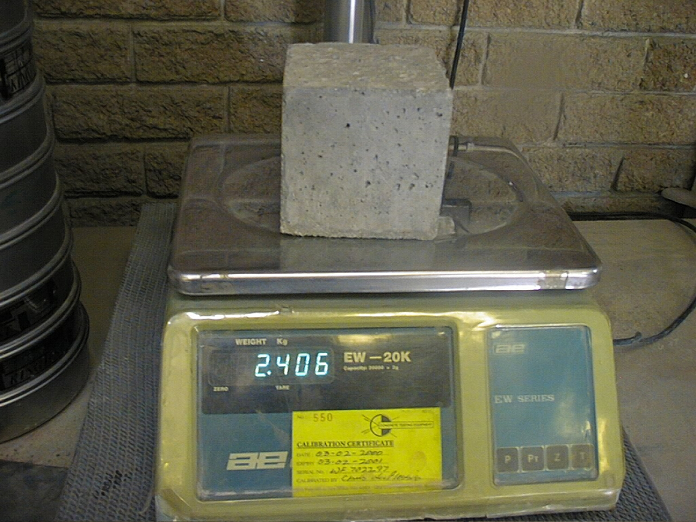
Relative density of concrete
22
The RD or SG of concrete depends upon our choice of materials.
If we use conventional materials, the RD will be close to 2.4
In other words, a 100mm cube (which has a volume of 1ℓ) weighs
2.4 kg and a cubic metre (which has a volume of 1000ℓ) will weigh
2400 kg or 2,4 tonnes.

Slide 26
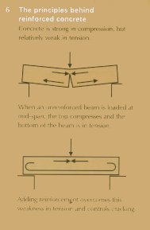

REINFORCED CONCRETE
Principle of reinforced concrete is that concrete is strong in compression & weak in tension
Invented by the Romans but failed who used bronze rods
First successfully used in 1854 (steel rods)

Slide 27
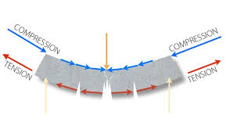
REINFORCED CONCRETE
Principle of reinforced concrete is that concrete is strong in compression & weak in tension

Slide 28
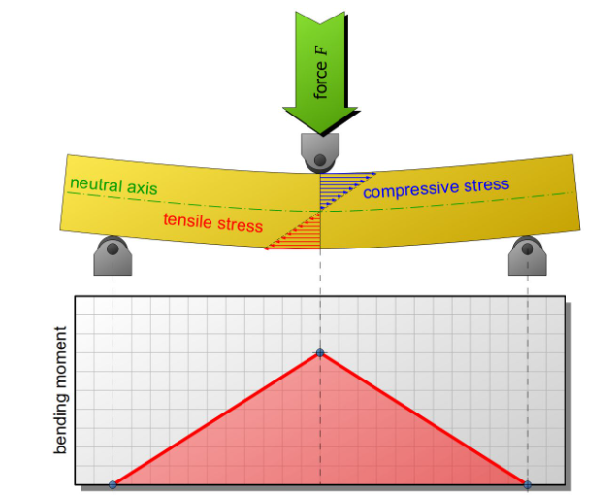
REINFORCED CONCRETE

Slide 29

The End
Feedback

